Slide 1

GSTN Analytics Hackathon Developing a Predictive Model in GST
Team ID: GSTN_435
Members:
Mohit Gupta
Harjot Singh
Gaurav Kumar Chaurasiya
Adamya Gaur

Slide 2


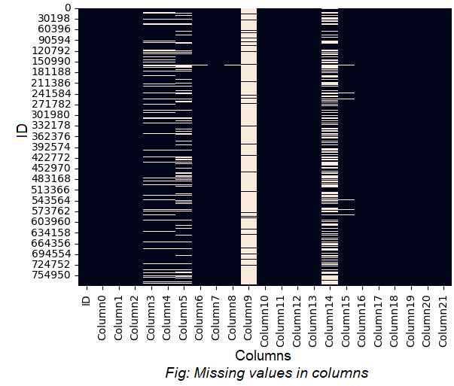
Exploratory Data Analysis
On comprehensive analysis including the range, mean, and standard deviation of variables, we found Column9 of data was missing for over 93% of the feature.
To look at correlations between features to see if there are some multicollinearity problems that could negatively affect the model, we used a heatmap.
The Target variable suffers from a class imbalance effect since this problem is dominated by entries belonging to one class, which can affect our model's training.

Slide 3

Data Preprocessing
Dropping Column
Dropped Column9. It had more than 93% missing data.
Imputing that much of missing data might result in bias and noise, so we decided to delete it completely.
Median Imputation
Median is primarily outlier resistant and constitutes an effective value that does not get dominated by the extreme value as well.
Standard Scaling
This step ensured that all variables were on a similar scale, facilitating better convergence during model training and improving the overall performance of our algorithms.
Data Splitting
The data was split into training and validation sets to ensure the model's performance would generalize well to unseen data.
80% of the data was used for training and 20% for validation.

Slide 4

Model Selection
We identified three algorithms that demonstrate strong performance and adaptability:
XGBoost is well-regarded for its robustness its regularization capabilities (L1 and L2) help reduce overfitting, making it a suitable choice.
CatBoost is particularly effective in managing features and offers strong performance even in the presence of missing values.
LightGBM is optimized for speed and efficiency, making it suitable for large datasets while maintaining competitive accuracy.
To enhance our model performance further, we implemented a custom voting classifier that combines the predictions of these three models. The CustomVotingClassifier aggregates the outputs from individual models using majority voting.
The custom voting mechanism not only combines the strengths of each individual model but also enhances overall predictive accuracy.

Slide 5

Hyperparameter Tuning
Hyperparameter tuning using both GridSearchCV and Optuna.
First, we have used GridSearchCV to search over various parameters including n_estimators, max_depth, learning_rate, subsample, and colsample_bytree.
We placed Optuna on top of this to further enhance our tuning process. Optuna is a hyperparameter optimization framework that employs a more efficient approach by using TPE in sampling the hyperparameters.

Slide 6
Model Evaluation and Metrics
(test set)
Precision
85.04%
Recall
93.77%
F1
Score
89.19%
ROC
AUC
96.03%
Balanced
Accuracy
96.03%
Log
Loss
0.049
Accuracy
97.86%

Slide 7
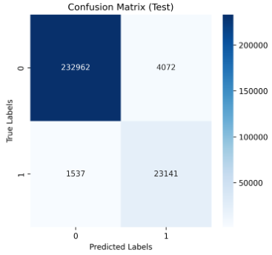
Results
The following results and confusion matrix were obtained:
Class | Metric | Precision | Recall | F1 Score | Support
Class 0 | Training | 0.99 | 0.99 | 0.99 | 568,880
 | Validation | 0.99 | 0.98 | 0.99 | 142,220
 | Testing | 0.99 | 0.98 | 0.99 | 237,034
Class 1 | Training | 0.87 | 0.95 | 0.91 | 59,226
 | Validation | 0.85 | 0.93 | 0.89 | 14,807
 | Testing | 0.85 | 0.94 | 0.89 | 24,678

Slide 8
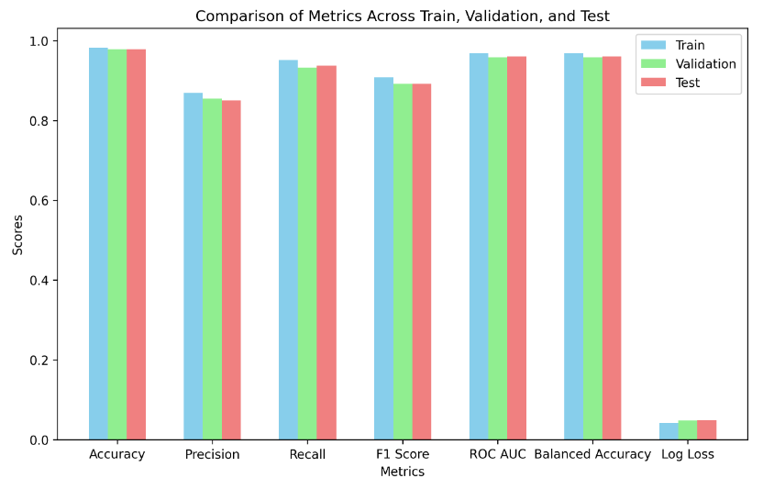
Visual Comparison of metrics

Slide 9
Conclusion
The model demonstrates high accuracy, precision, recall, and F1 scores across training, validation, and testing datasets, highlighting its effectiveness in handling a highly imbalanced classification problem.
The metrics indicate strong performance for the minority class, suggesting that the model is well-tuned for practical applications. The consistent results across datasets also imply that the model is robust and generalizes well.
Further improvements could focus on reducing false positives and enhancing interpretability for end-users.
We believe our effective and insightful solution might strengthen the GST analytics framework and contribute to the nation’s progress.

Slide 10

Thankyou for your time

